Slide 1
Tetris+
Brendan N and Sebastian H

Slide 2
UML Diagram

Slide 3
JPanel
«interface»
ActionListener
«interface»
KeyListener
Arcade
ControlPanel
TetrisBoard
GameStats
«interface»
JavaArcade
Polyomino
Block
Monomino
Domino
Triomino
Tetromino
Pentomino

Slide 4
Interfaces

Slide 5
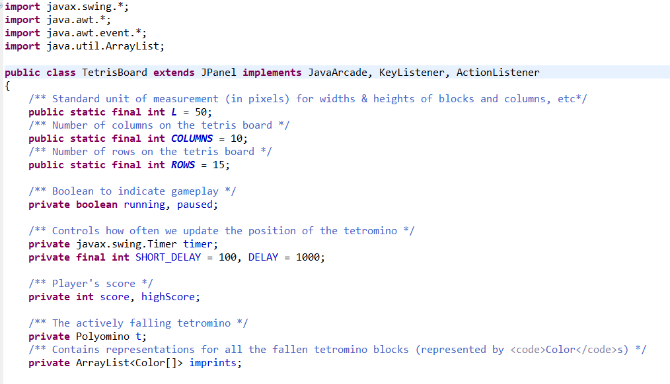
Interfaces Used
JavaArcade
KeyListener
ActionListener

Slide 6
Abstract Classes

Slide 7
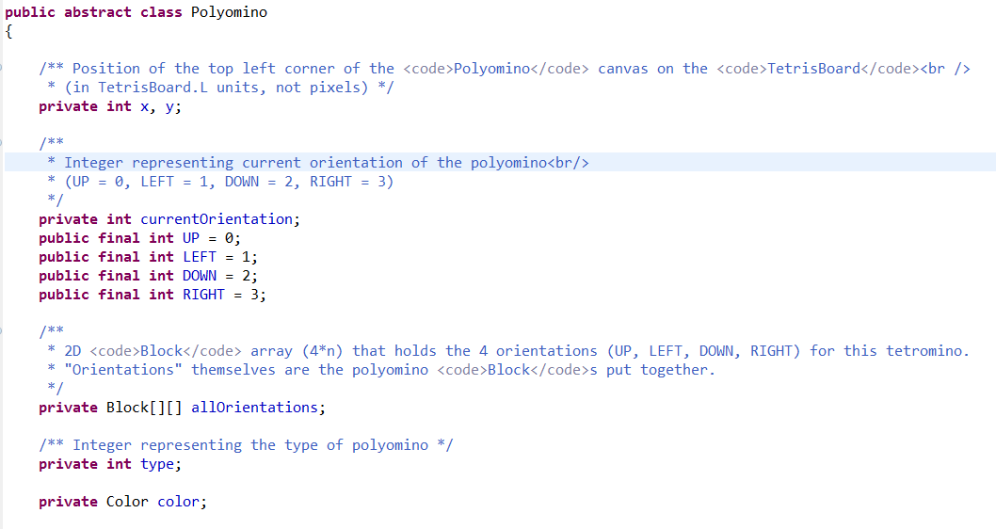
FIELDS
CONSTRUCTORS: wildly different for each child class
METHODS: getName(), getPolyomino(), toString()

Slide 8
Polymorphism

Slide 9
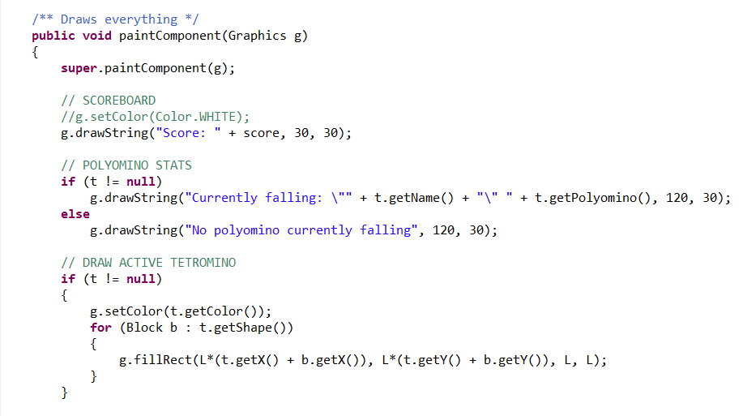
From TetrisBoard.java

Slide 10
ArrayLists

Slide 11
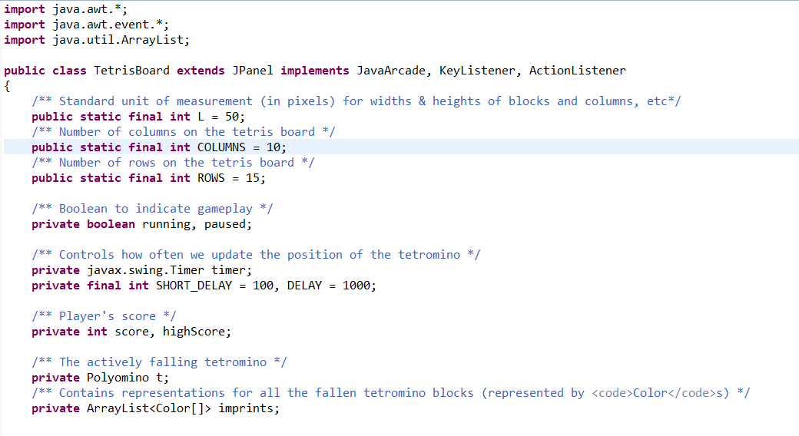

Slide 12
Demonstration of
T
e
t
r
i
+
s

Slide 13

Any Questions?

